Slide 1
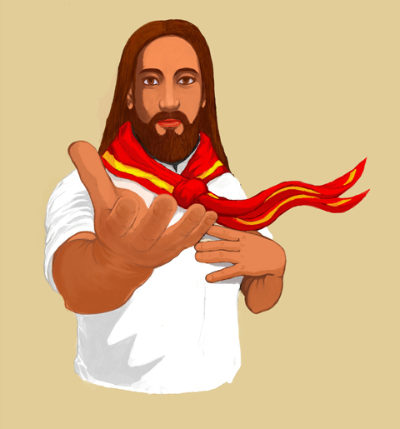
Hiểu Biết Phong Trào
Thiếu Nhi Thánh Thể Việt Nam

Slide 2
Name & Origin
1865 | Toulouse | France: TNTT is originated from the Apostleship of Prayer. The Apostleship of Prayer was found by two priests, Léonard Cross and Henri Ramière.
1915: Father Albert Bessières formed the Eucharistic Crusade as a branch of the Apostleship of Prayer. The original goals are to bring the children closer to God and to help strengthen the youth’s faith through a life of prayers, sacraments, services, and sacrifices based on the discernment of God’s will.
1929 | Ha Noi | Vietnam: The Eucharistic Crusade was brought to Vietnam by the missionaries from the Sulpicians.
1964: The Vietnamese Eucharistic Crusade was transformed into the Vietnamese Eucharistic Youth Society and was approved by the Vietnamese National Conference of Catholic Bishops and the Government. This new transition integrated both prayer and apostolate services.
After 1975: Vietnamese Refugees flee the country, settled to many countries around the world and brought the group back to life.
Current: The Vietnamese Eucharistic Youth Society in the USA is currently divided into 8 regions, with about 110 local chapters, approximately 16,000 members under the leadership of 1,800 youth leaders, including chaplains, and supporting members.

Slide 3

MISSON STATEMENT
The main goals of the Vietnamese Eucharistic Youth Society are:
Educate youths in both social and spiritual life and help them become a competent individual and a responsible Christian.
Organize and guide all youths in spreading the good news and engaging in the community through apostolate services.

Slide 4
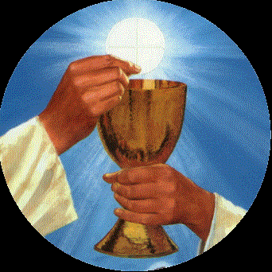


FOUNDATIONS
The foundations for teaching youths in all activities:
The Eucharistic
The Bible
The Church’s
Teaching

Slide 5
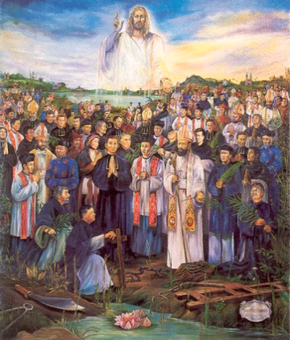

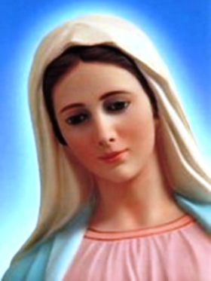
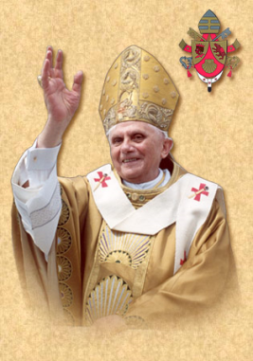
Principles
1 - To promote constant devotion to the Eucharist by living the word of God, be united with Him through prayers, receives Holy Communion, offer sacrifices and perform apostolate services.
2 - To love and venerate the Virgin Mary, Mother of our Savior, as the model for discipleship.
3 - To honor our Vietnamese Martyrs; follow their examples and become witnesses of Christ.
4 - To promote prayers for the Holy Father who is the Vicar of Christ on earth and to pray for the needs of the whole Church.
5 - To improve oneself; preserve and promote the Vietnamese traditions and culture.

Slide 6


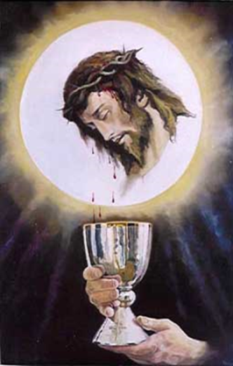
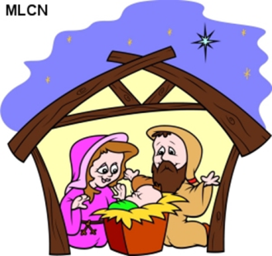
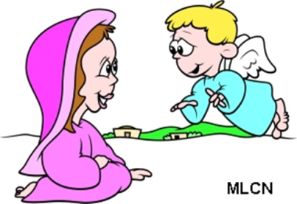
MƯỜI ĐIỀU TÂM NIỆM TNTT
Đoàn viên Thiếu Nhi Thánh Thể luôn ghi nhớ và thực thi Mười Điều Tâm Niệm sau:
1 - Offer prayer often, morning and night prayers
2 – Daily Communion and Visit the Eucharist
3 – Make sacrifices, service with full heart
4 – Perform apostolic works by setting good examples
5 - Be obedience, listen to the elder and superior

Slide 7
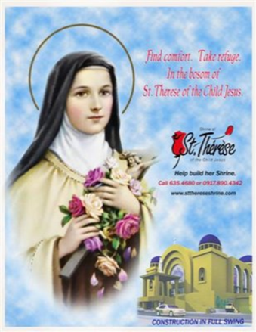
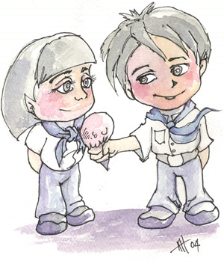


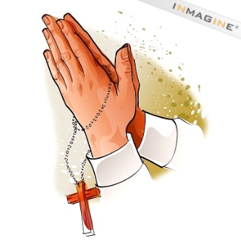
MƯỜI ĐIỀU TÂM NIỆM TNTT
6 - Be modest, well-behaved and respectful
7 - Be kind and generous to everyone
8 - Be honest, have integrity in words and actions
9 - Be responsible in fulfilling everyday duties
10 - Complete the spiritual bouquet

Slide 8
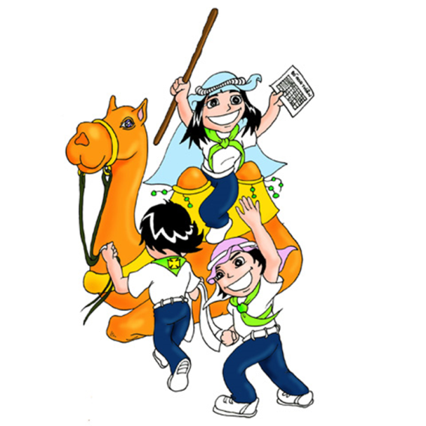
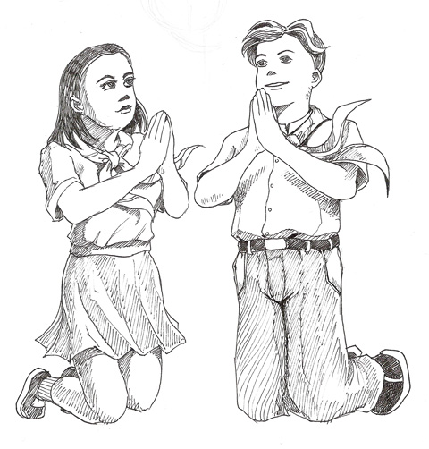
PHƯƠNG PHÁP GIÁO DỤC
The Vietnamese Eucharistic Youth Society uses appropriate educational methods to teach youths in both aspects of the social and spiritual life.
  Social (natural): Teaches youths about God, the Bible, and the Church through activities such as games, singing, dancing, meeting, camping, community services and doing charity projects.
  Spiritual (supernatural): Guides youths in their spiritual life through activities such as Living the Eucharist Day, Eucharistic Adoration, Spiritual Bouquet, Retreat, and Bible Reading.

Slide 9
Sống Ngày Thánh Thể
Living a Eucharist Day
  What is Living a day in the Eucharist?
    A spiritual way of teaching of TNTT
    Purpose: to help you to become a saint
  How do you live a day in the Eucharist?
    Start with saying a morning prayer AKA Dâng Ngày
    Go through the days and do the following as much as you can:
      Attend mass & receive communion
      Read a passage in the bible
      Pray & pray the rossary
      make sacrifices: doing the things that make others happy
      Apostolic services or doing community services
    End the day with the evening prayer AKA Dâng Đêm

Slide 10
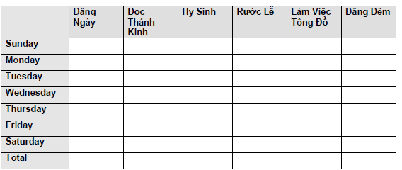
Sống Ngày Thánh Thể
Living a Eucharist Day
in short
Completing Your Spiritual Bouquet as Offering to Jesus
Put one mark for every task you completed on any given day
Total at the end of the week.

Slide 11
English Version
Organizational Structure
Vietnamese Eucharistic Youth Society in the U.S.
National Headquarter
Region 1
League**
(of Chapters or Individual Chapter)
League
(of Chapters or Individual Chapter)
Individual Chapter(s)
Individual Chapter(s)
There are:
8 regions
110 local chapters,
approximately 16,000 members
**There should be one league per diocese

Slide 12
Anre Dung Lac Hierarchy
Chaplain
(Cha An)
President
Tr. Lap
Director of Academic Affairs
Tr. The Duc
Director of Organizational Affairs
Tr. Duc
Parent
Committee
Advisory Committee
Treasurer
Tr. Trang
Secretary
Tr. Mai Anh
Nganh Au Nhi
Leader
Tr. Uyen
Nganh Thieu Nhi
Leader
Tr. Phuong
Nganh Nghia Si
Leader
Tr. Viet
Nganh Hiep Si
Leader
Tr. Ho

Slide 13

HẾT

